Slide 1

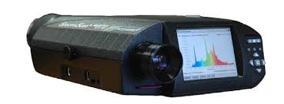
Put in filters
100 cm
100 cm

